Slide 1


Progress Report 21/12/2020
Georgios Bakas

Slide 2
Outline
CERN and the CMS Experiment
Detector Control System
Data Analysis
Detector Upgrades
RD51
Conclusions

Slide 3
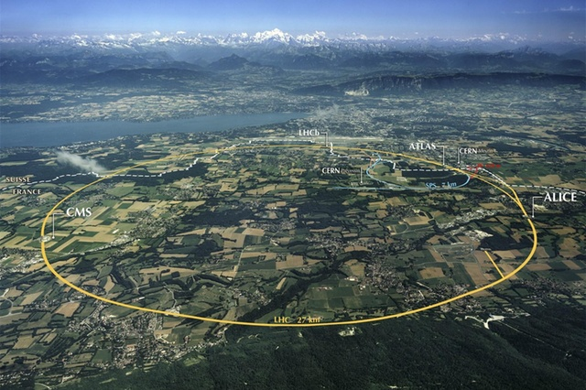
CERN – LHC
CERN, European laboratory for particle and nuclear physics.
Various experiments.
Large Hadron Collider (LHC)
27Km circumference
Colliding Protons
Design energy up to 14 TeV.
Beams collide at 4 predefined points.
4 detectors/experiments.
ALICE, ATLAS, CMS, LHCb

Slide 4
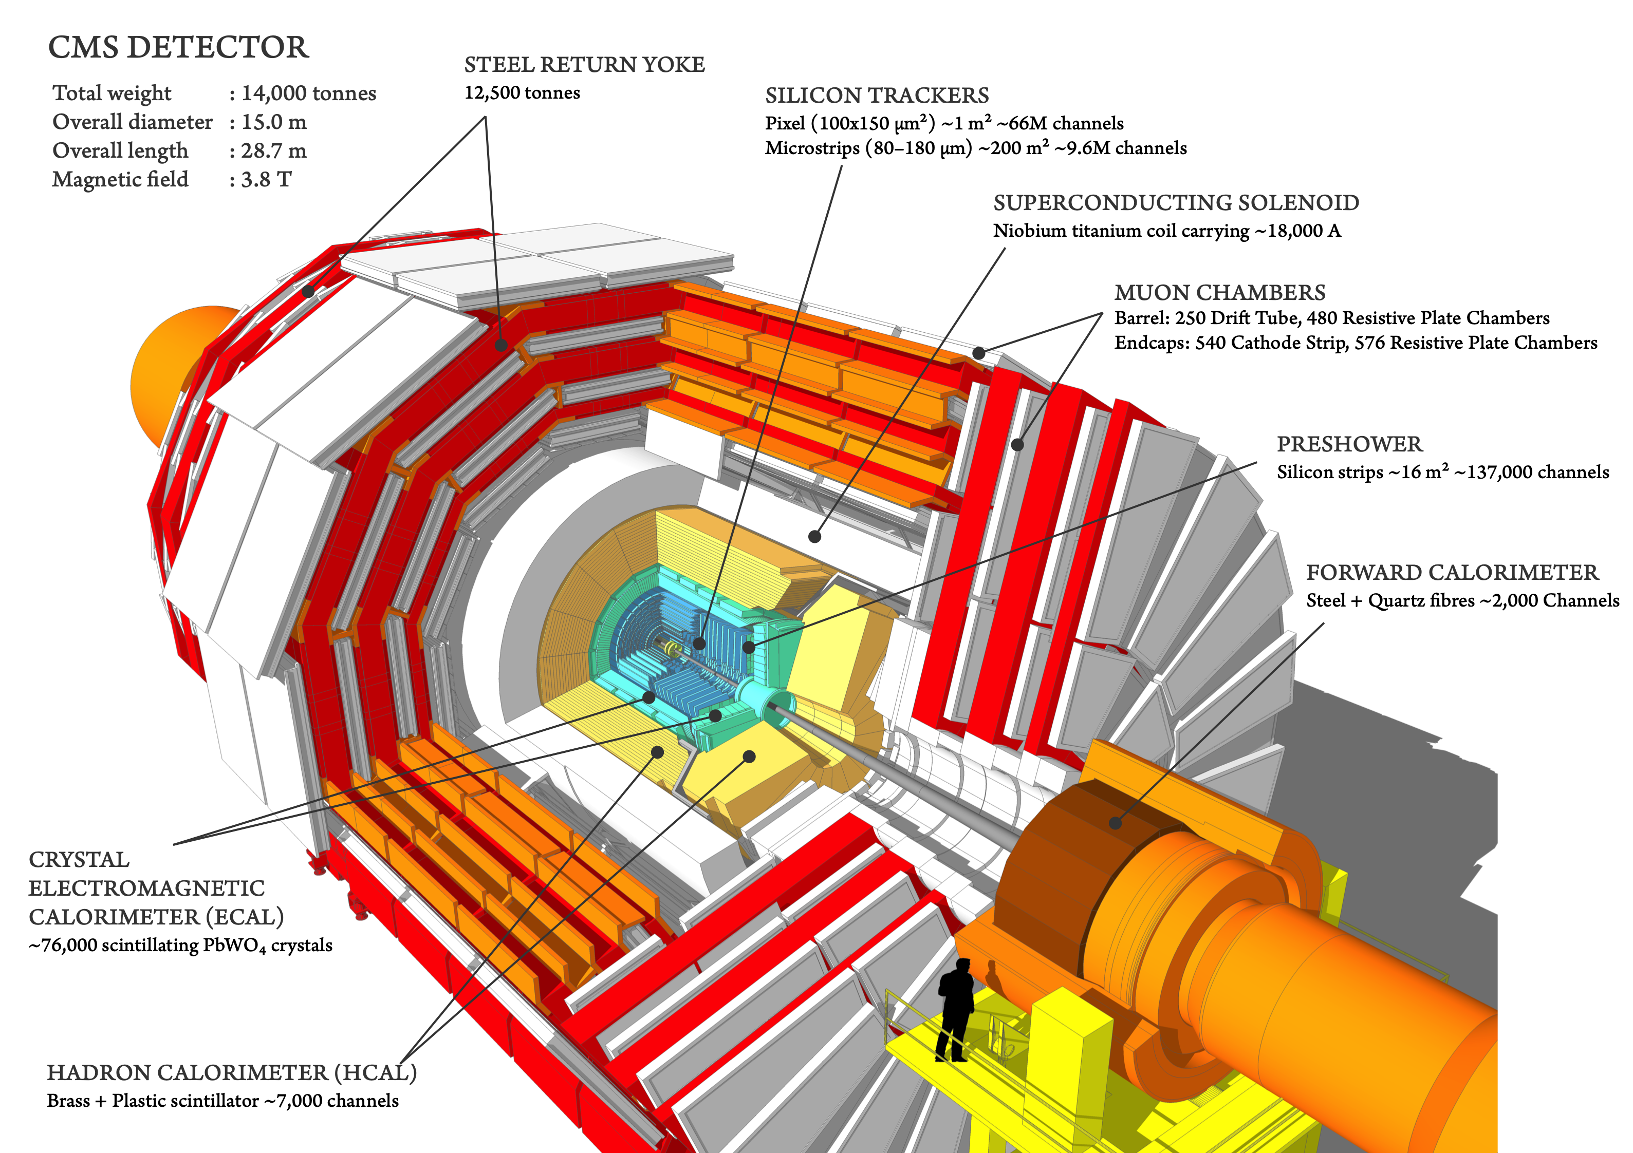
CMS Experiment

Slide 5
Detector Control System
Control the detector
Monitor the conditions under which it operates
Sophisticated and sensitive equipment (more than 6 million parameters)
Take necessary actions
Use the collected data as a first indication for determining the quality of the physics data collected.

Slide 6
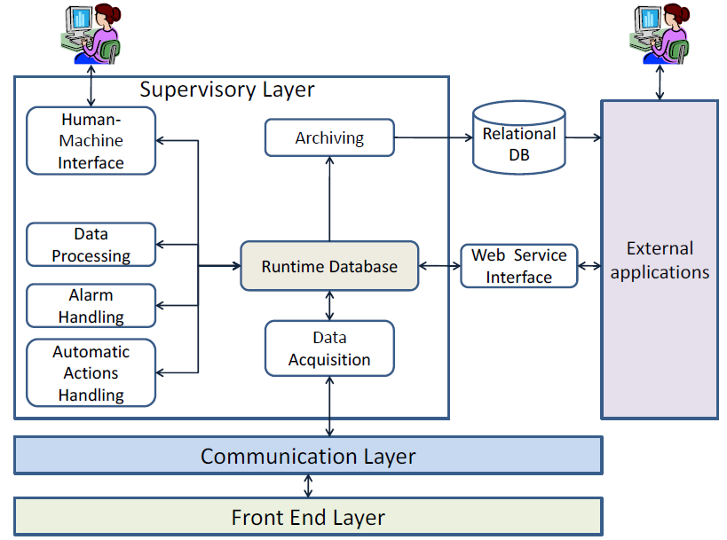
Control Systems
SCADA system (Supervisory Control And Data Acquisition)
Monitor and Control a remote process
Factories, airports, physics experiments
Toolkits
Tools for developing the supervisory layer
Ability to connect to hardware (communication layer, drivers)

Slide 7






Control Systems at CERN
Experiment’s Framework
JCOP
FW
Distributed Systems
Runtime Database
OS Independent
Native language, GEDI
Embedded drivers
WinCC_OA

Slide 8

The CMS Detector Control System
Central System
More than 35 individual systems
Minimal systems modified by a bunch of JCOP-like CMS components
Centralized
Central DCS responsible for the maintenance of all the projects
DCS Shifter
Tracker
ECAL
HCAL
Muons
…

Slide 9
Role in the DCS
Members of the CMS central DCS team
System administration
Maintenance and improvement of the existing system
Developed/improved various applications used either in the control room by the operators or by subsystem experts
Support in the CMS experiment in control system manners. Problem fixing or suggestions for future developments

Slide 10
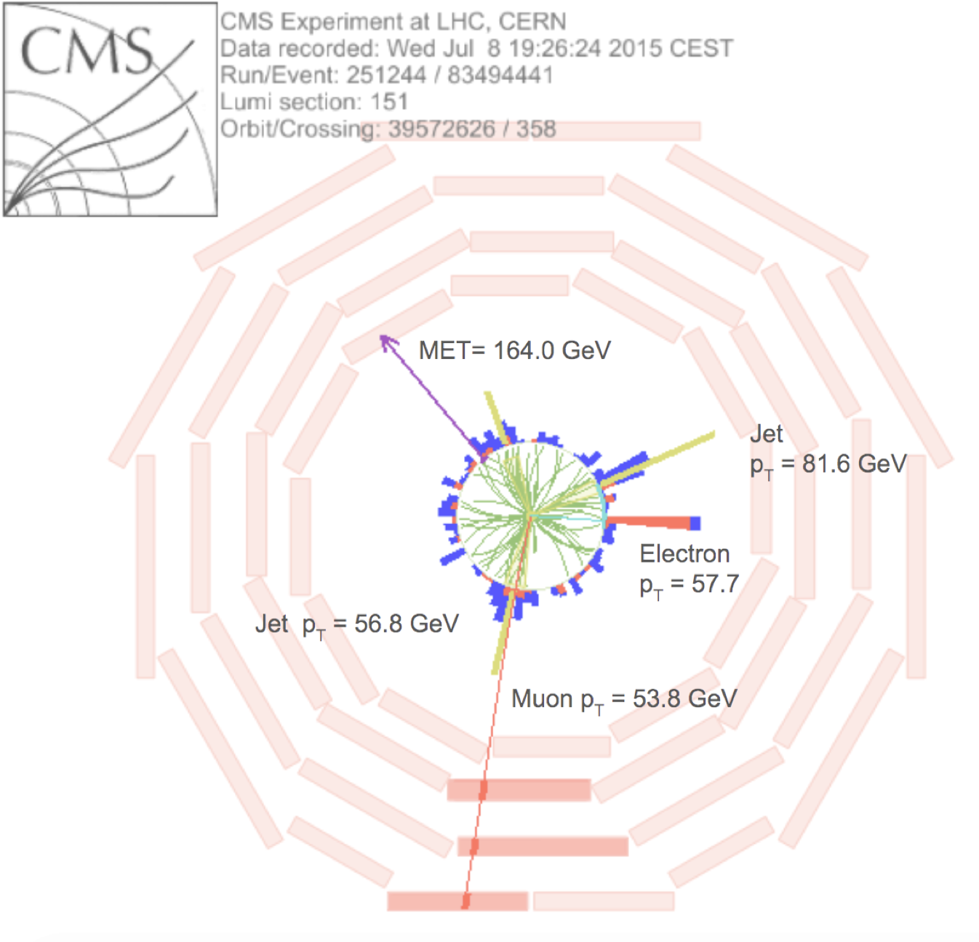
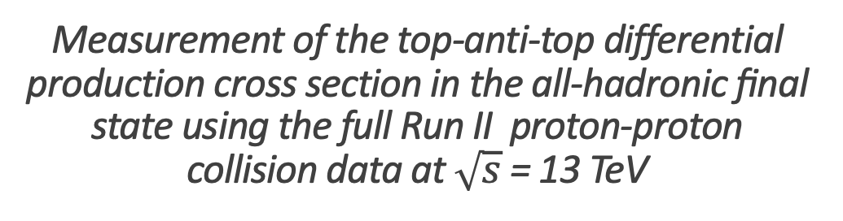
Measurement of the top-anti-top differential production cross section in the all-hadronic ﬁnal state using the full Run II proton-proton collision data at $\sqrt{s}$ = 13 TeV

Slide 11
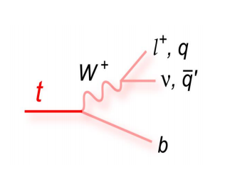
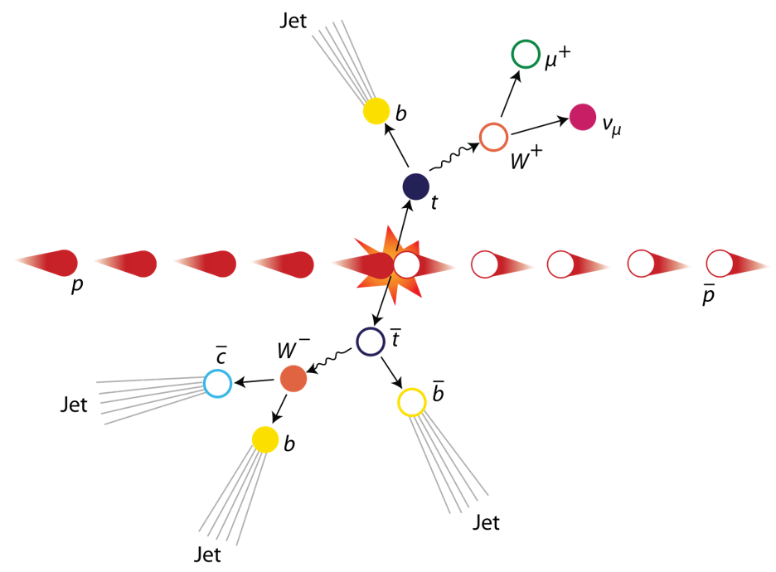
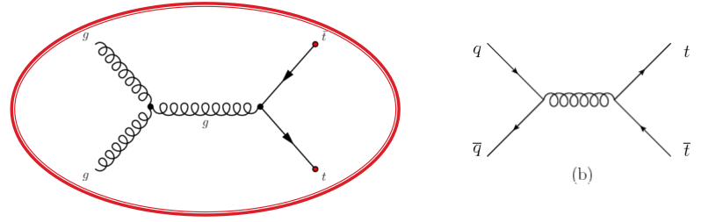
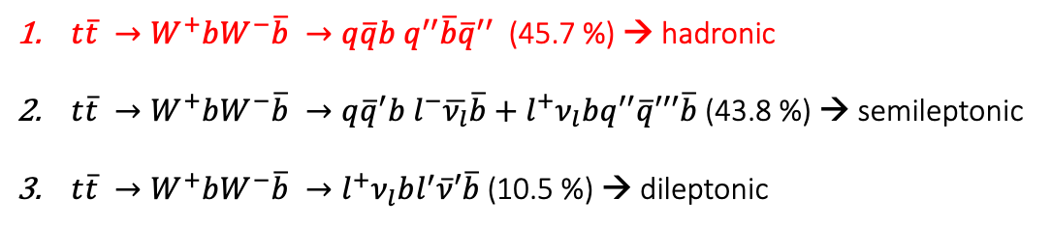
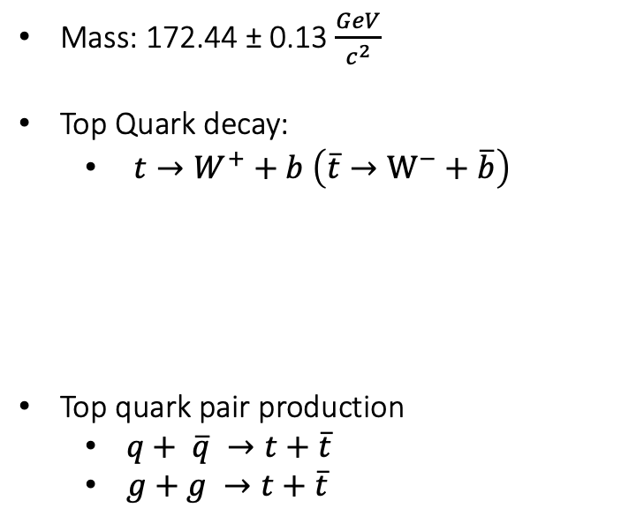
Top Quark -- Top AntiTop system decay
Mass: 172.44 ± 0.13 $\frac{GeV}{c^{2}}$
Top Quark decay:
$t→W^{+}+b \left(\overline{t}→W^{−}+\overline{b}\right)$
Top quark pair production
$q+ \overline{q} →t+\overline{t}$
$g+g →t+\overline{t}$
$t\overline{t} →W^{+}bW^{−}\overline{b} →q\overline{q}b q^{′′}\overline{b}{\overline{q}}^{′′}$ (45.7 %) → hadronic
$t\overline{t} →W^{+}bW^{−}\overline{b} →q{\overline{q}}^{′}b l^{−}\overline{ν_{l}}\overline{b}+l^{+}ν_{l}bq^{′′}\overline{q}′′′\overline{b}$ (43.8 %) → semileptonic
$t\overline{t} →W^{+}bW^{−}\overline{b} →l^{+}ν_{l}bl^{′}\overline{ν}′\overline{b}$(10.5 %) → dileptonic
Gluon Fusion is dominant at LHC

Slide 12
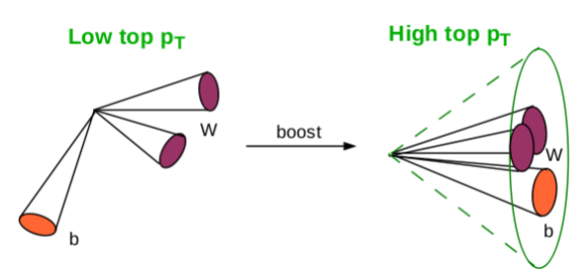
Boosted Jets
Boosted Jets are jets with high p_{T} ( > 400 GeV)
Aim is the reconstruction of two big jets that contain the decay products of the top-antitop quark pair decay
Motivation
With resolved hypothesis we measure the top pair cross section up to ~500GeV
There is an interesting discrepancy with theory (p_{T} slope)
In order to see what happens in bigger p_{T} ‘s → boosted
Why Boosted jets?
Single “fat” jet: No combinatorial background
At high top p_{T} the hadronic decay is easier to reconstruct than the leptonic
In order to identify boosted jets
Use of sophisticated reconstruction techniques to identify the substructure within the jet
SoftDrop technique to eliminate soft contributions

Slide 13
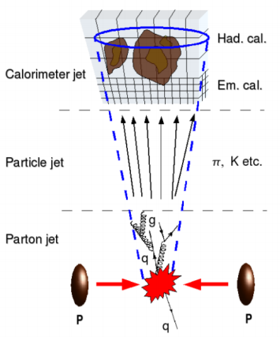
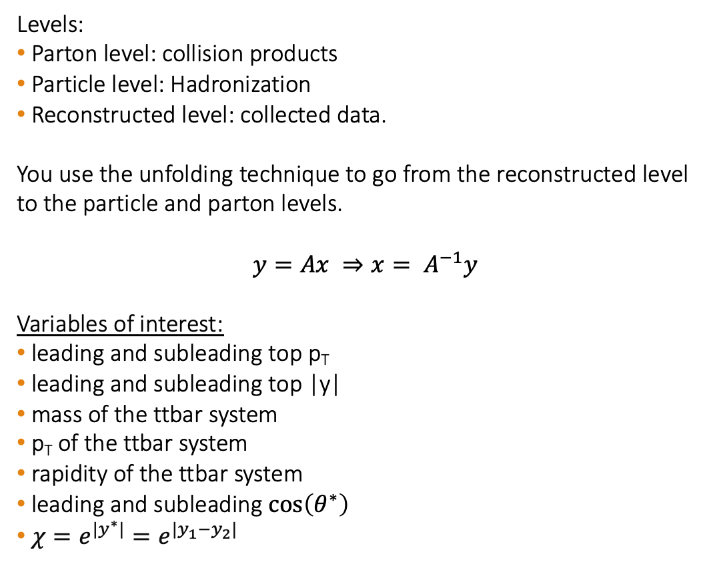
Analysis Overview
Levels:
Parton level: collision products
Particle level: Hadronization
Reconstructed level: collected data.
You use the unfolding technique to go from the reconstructed level to the particle and parton levels.
$$y=Ax ⇒x= A^{−1}y$$
Variables of interest:
leading and subleading top p_{T}
leading and subleading top |y|
mass of the ttbar system
p_{T} of the ttbar system
rapidity of the ttbar system
leading and subleading $\cos\left(θ^{∗}\right)$
$χ=e^{{|y}^{∗}|}=e^{|y_{1}−y_{2}|}$

Slide 14
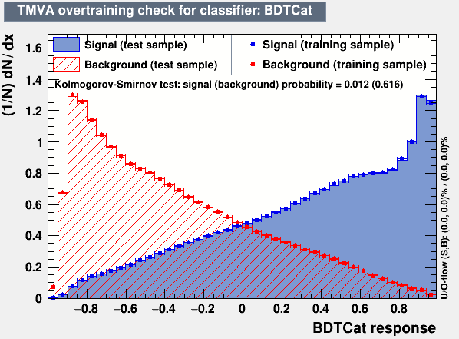
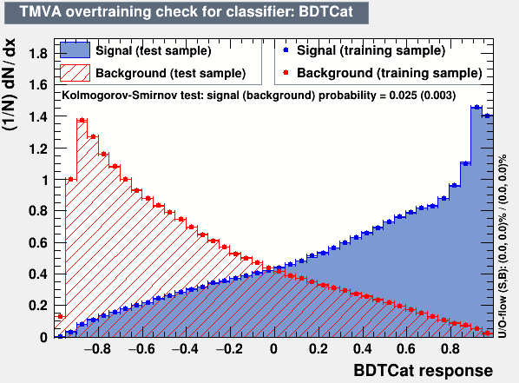
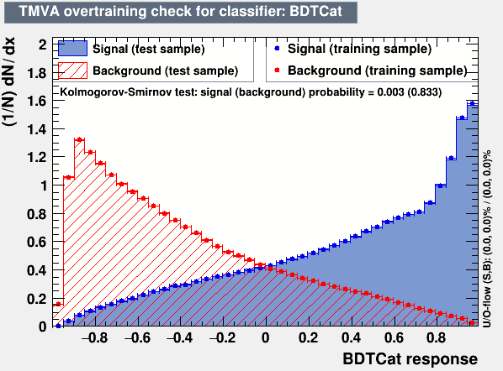
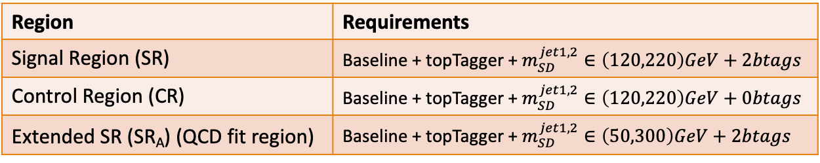
Overview
2016
2017
Baseline Reconstructed level cuts:
nJets > 1, nLeptons = 0, Dijet mass (mJJ) > 1000 GeV
Leading and Subleading jet p_{T} > 400 GeV
Leading and Subleading absolute jet eta |η|<2.4
Btagging selection:
How many subjets are b-tagged
In house developed top Tagger:
Boosted Decision Tree
Working points (2016: 0.2, 2017: 0.0, 2018: 0.1)
Goal is to Unfold to the Parton And Particle Levels
Data driven method for QCD subtraction
2018
Region | Requirements
Signal Region (SR) | Baseline + topTagger + $m_{SD}^{jet1,2}∈\left(120,220\right)GeV+2btags$
Control Region (CR) | Baseline + topTagger + $m_{SD}^{jet1,2}∈\left(120,220\right)GeV+0btags$
Extended SR (SR_{A}) (QCD fit region) | Baseline + topTagger + $m_{SD}^{jet1,2}∈\left(50,300\right)GeV+2btags$

Slide 15
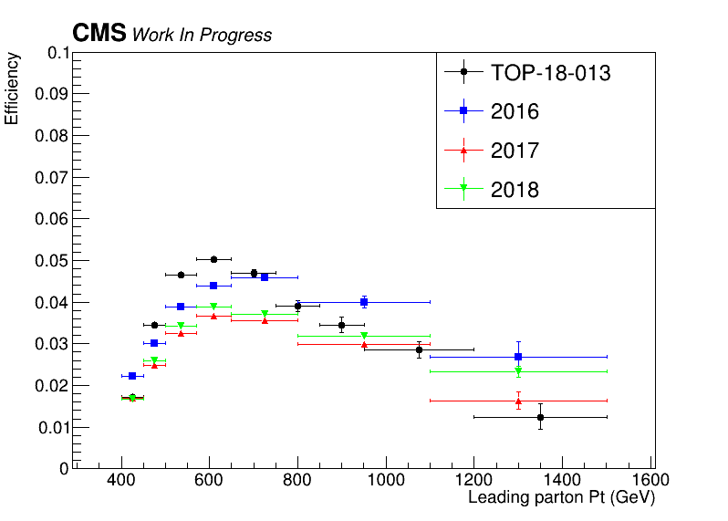
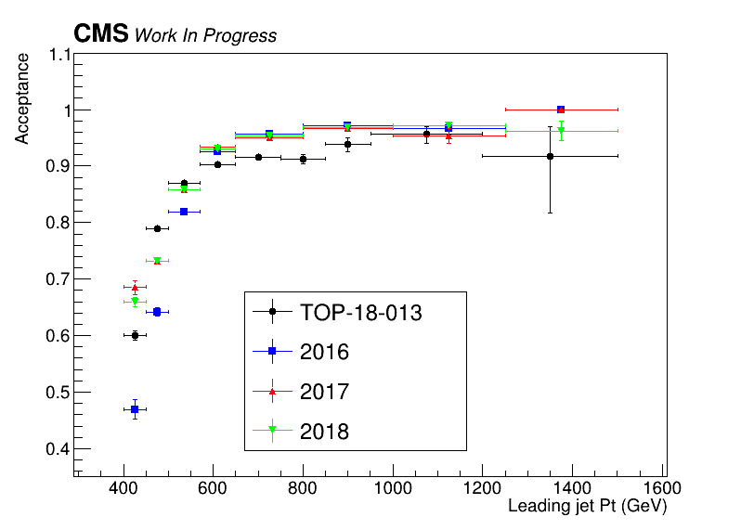
Efficiency and Acceptance for 2016, 2017 and 2018 and previous 2016 analysis

Slide 16
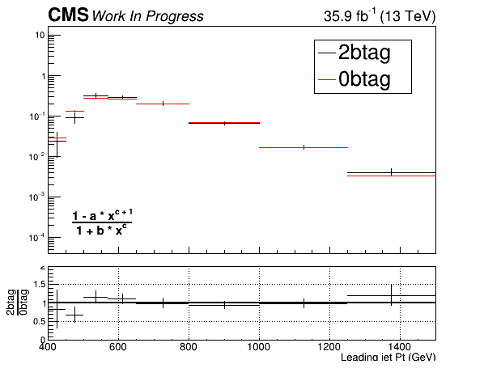
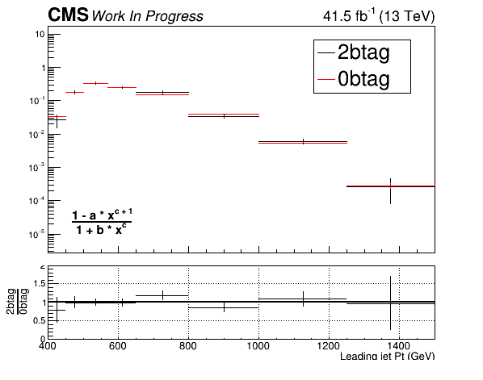
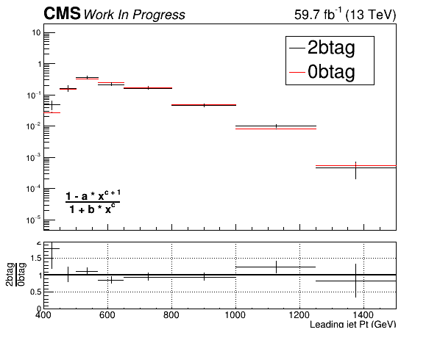
QCD Closure Tests ’16, ‘17, ’18 (corrected) for leading JetPt
2016
2017
2018

Slide 17
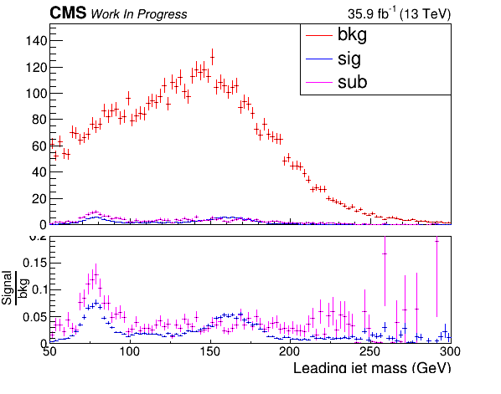
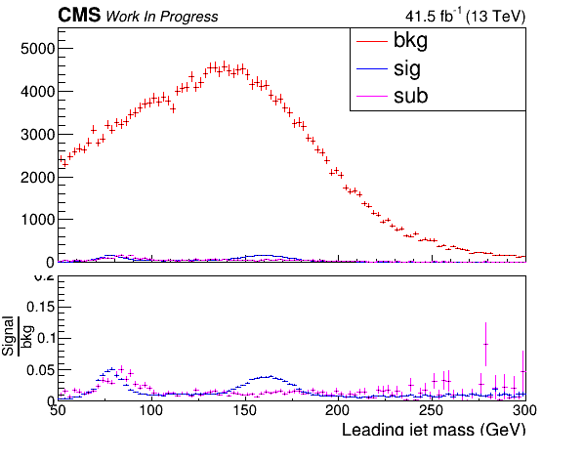
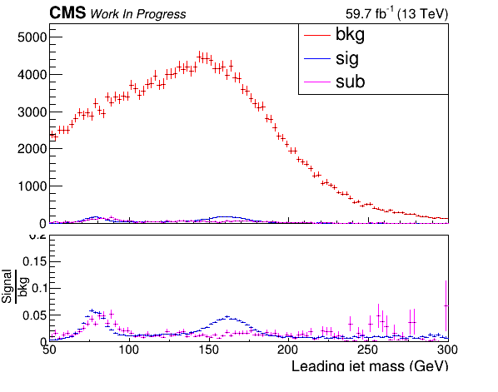
CR Contamination ’16,’17,’18 for the leading Jet Mass (softDrop)
2016
2017
2018

Slide 18
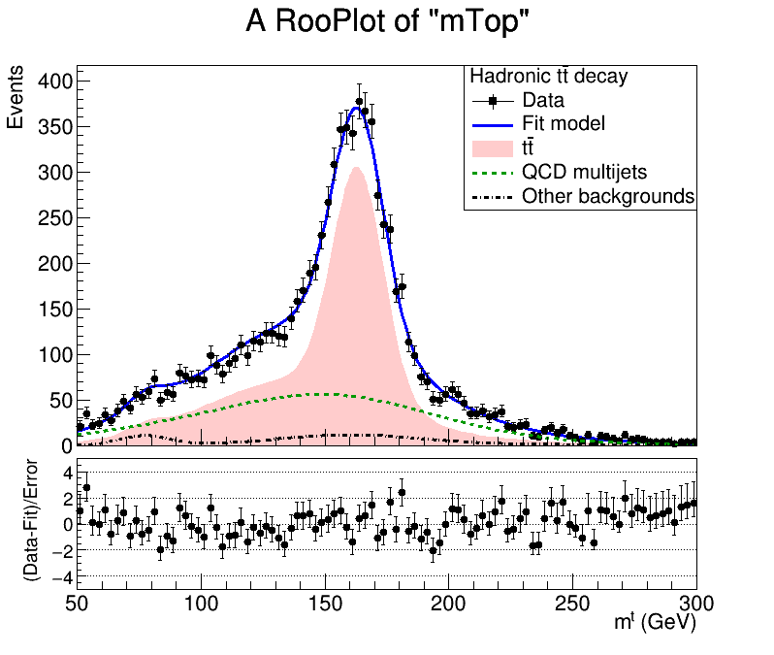
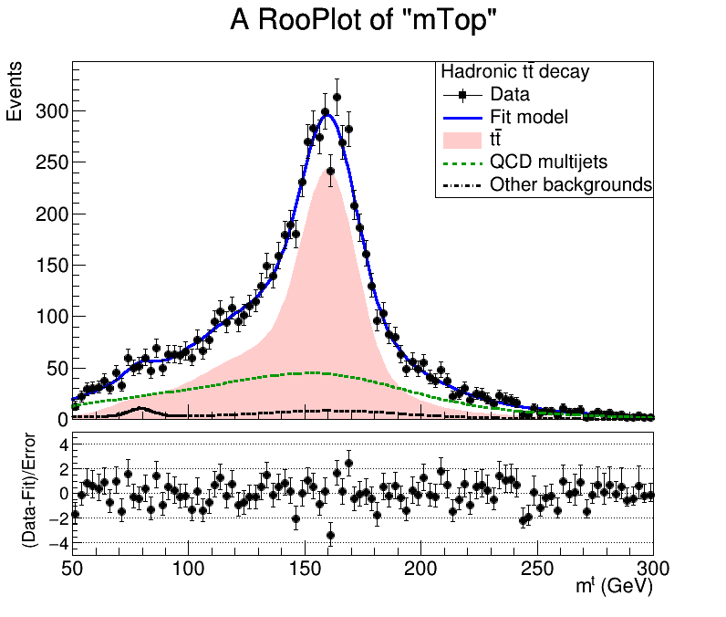
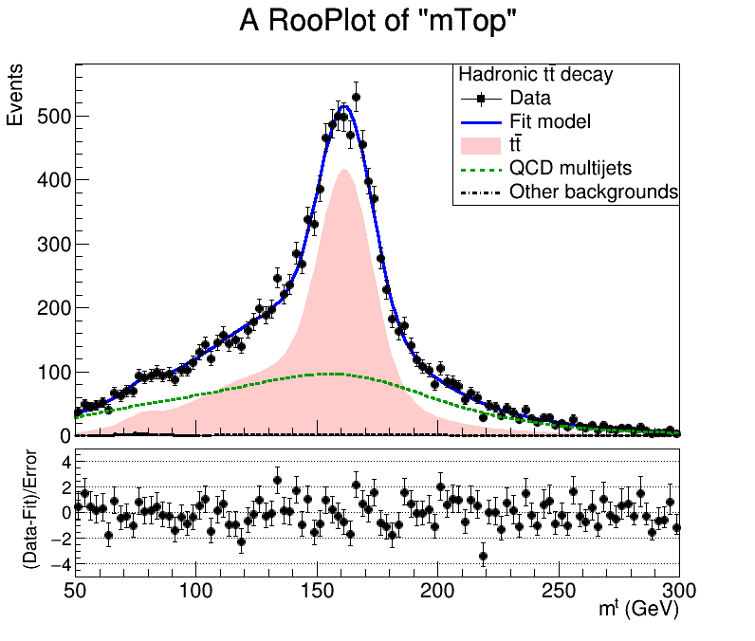
Mass Fit in Signal Region for 2016, 2017, 2018
Signal Region (2btag) (2016)
Signal Region (2btag) (2017)
Signal Region (2btag) (2018)
Signal Strength: r = 0.69 ± 0.026
Signal Strength: r = 0.64 ± 0.024
Signal Strength: r = 0.68 ± 0.02
Result of the fit on data in SR. The red area shows the ttbar contribution, the green line shows the QCD, and the black line shows the subdominant backgrounds

Slide 19
Signal Extraction
Fitted number of QCD events in SR_{A}
Measured dist from data
QCD shape taken from Data (CR)
$$S\left(x_{reco}\right)=D\left(x_{reco}\right)−C_{bkg}^{yield}N_{QCD}^{fit}C_{QCD}^{shape}\left(x_{reco}\right)Q\left(x_{reco}\right)−B(x_{reco})$$
Fiducial Yield
Transfer factor from SR_{A} to SR
QCD shape correction factor
Subdominant bkg shape and contribution (MC)
Where x_{reco} is the respected variable of interest (ttbar mass, pt, rapidity, leading and subleading jetPt and |jetY|)
We deploy a fit in the Signal Region (2btag) to extract the $N_{QCD}^{fit}$
$$D{\left(m^{t}\right)}^{(i)}=N_{tt}^{(i)}T^{(i)}\left(m^{t},k_{MassScale}, k_{MassResolution}\right)+N_{bkg}^{(i)}B\left(m^{t} \right)\left(1+k_{1}x\right)+N_{sub}^{(i)}O^{(i)}\left(m^{t}\right)$$

Slide 20
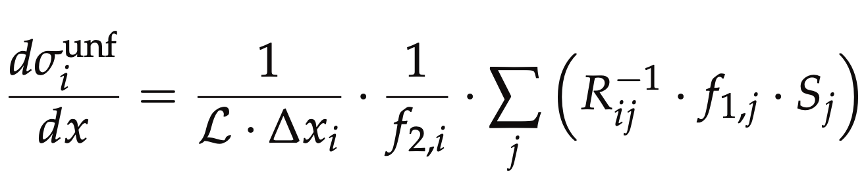
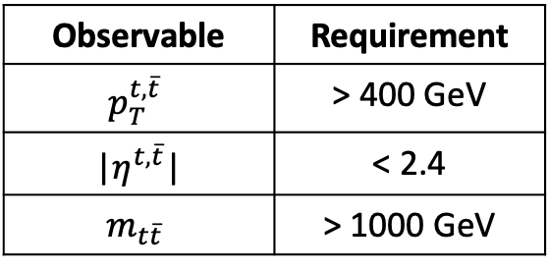
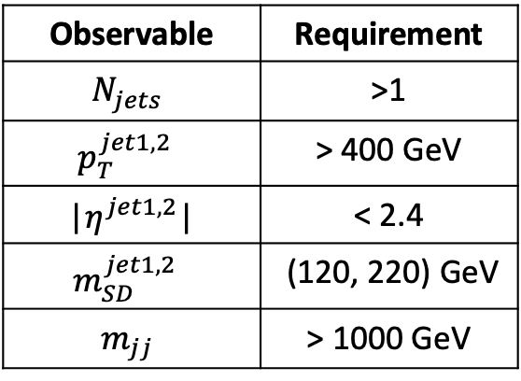
Parton & Particle levels
Particle level Top Candidates
Parton
Observable | Requirement
$$N_{jets}$$ | >1
$$p_{T}^{jet1, 2 }$$ | > 400 GeV
|$η^{jet1, 2}$| | < 2.4
$$m_{SD}^{jet1, 2 }$$ | (120, 220) GeV
$$m_{jj}$$ | > 1000 GeV
Observable | Requirement
$$p_{T}^{t,\overline{t}}$$ | > 400 GeV
|$η^{t,\overline{t}}$| | < 2.4
$$m_{t\overline{t}}$$ | > 1000 GeV
Parton Phase space
Reco/Fiducial Phase space
efficiency of the reco+true selection
reco efficiency of the reco+true selection
migration matrix
Unfolding: simple response matrix inversion w/o regularisation

Slide 21
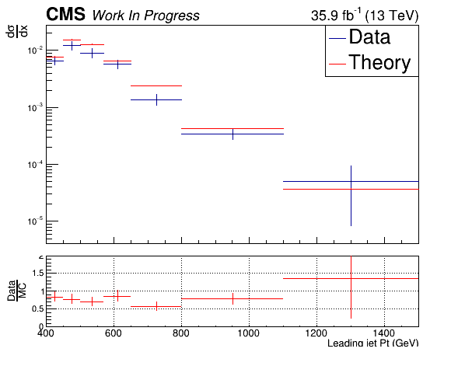
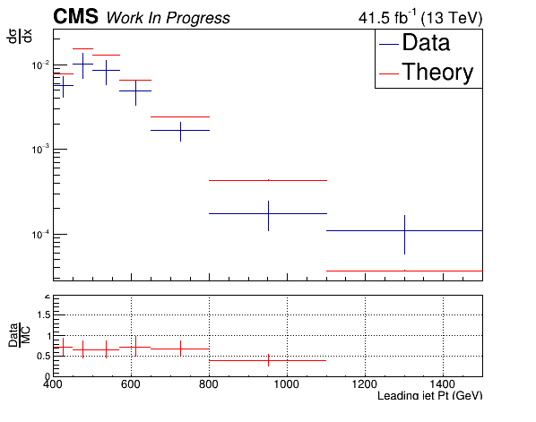
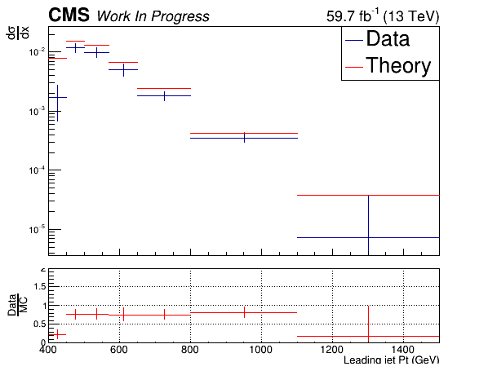
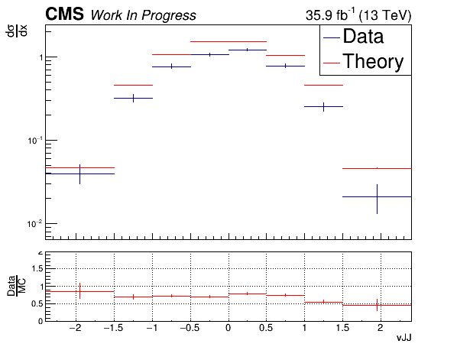
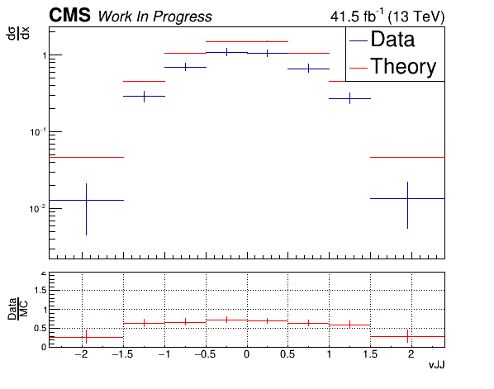
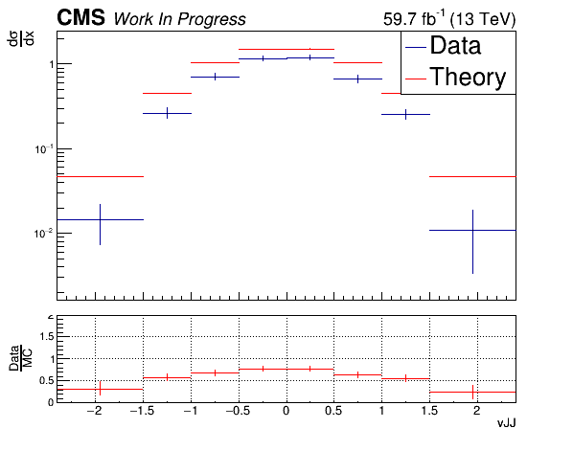
Unfolding - Extrapolation to Parton Level, Data vs MC
(2016)
(2017)
(2018)

Slide 22
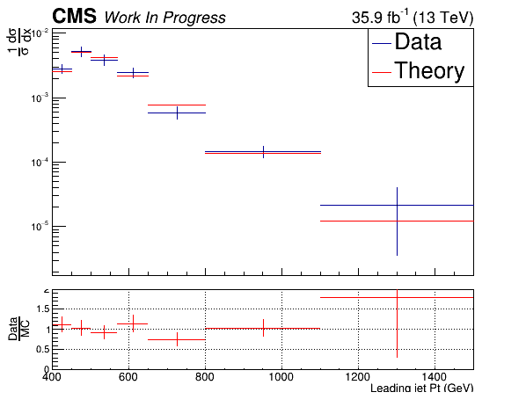
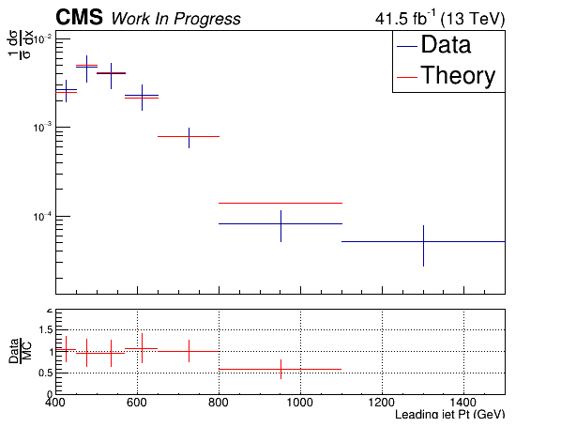
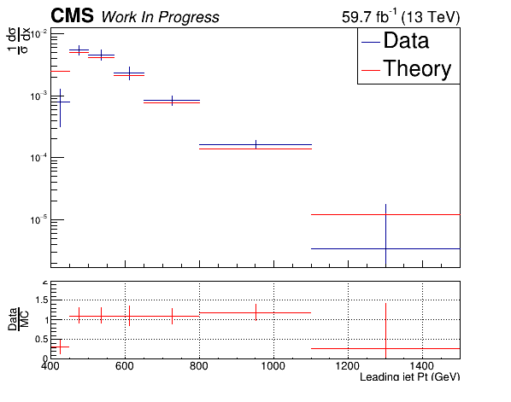
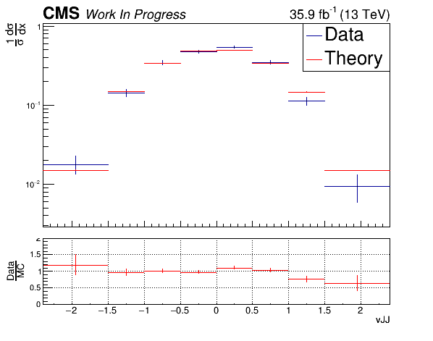
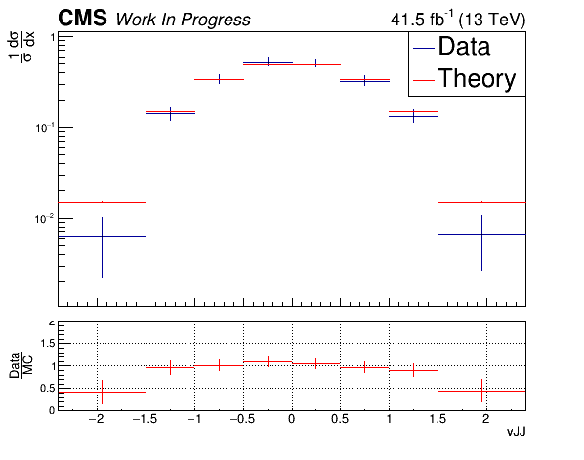
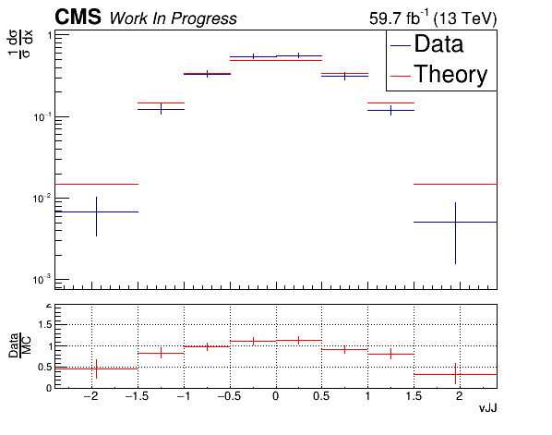
Unfolding - Extrapolation to Parton Level, Data vs MC (Normalised)
(2016)
(2017)
(2018)

Slide 23
CERN Phase2 upgrade
LHC will upgrade to High Luminosity LHC (HL - LHC) between 2023 and 2025
Higher luminosity
Higher radiation doses than the ones the detectors were designed for
Higher pileup
CMS will replace most of its subdetectors to mitigate with the LHC upgrades
High Granularity CALorimeter (HGCAL) will replace the endcap calorimeters.

Slide 24
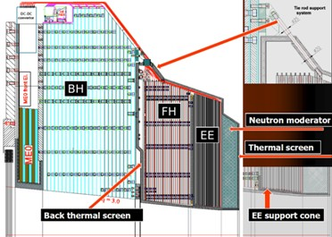
High Granularity Calorimeter (HGCAL)
Phase 2 Upgrade
ECAL and HCAL won’t exist in near future on endcaps
HGCAL in endcaps. Why?
Radiation hardness because of bigger lumi
Endcaps have maximum radiation
Bigger Lumi → higher granularity → more modules/ind. Components
Silicon detector

Slide 25
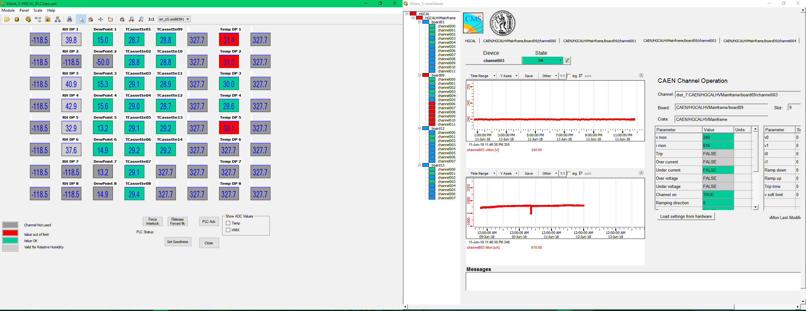
High Granularity Calorimeter (HGCAL)

Slide 26
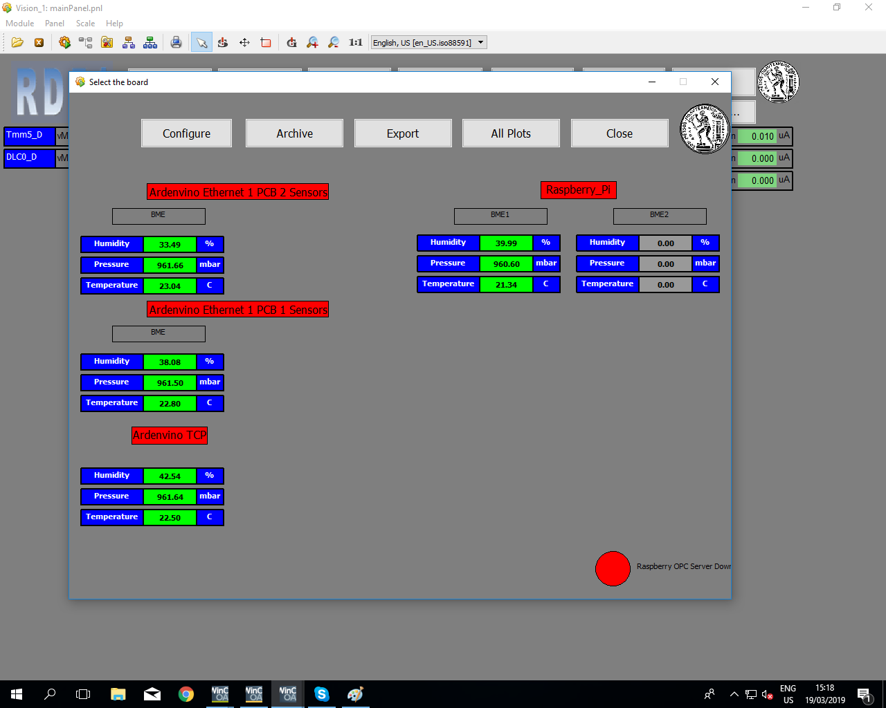
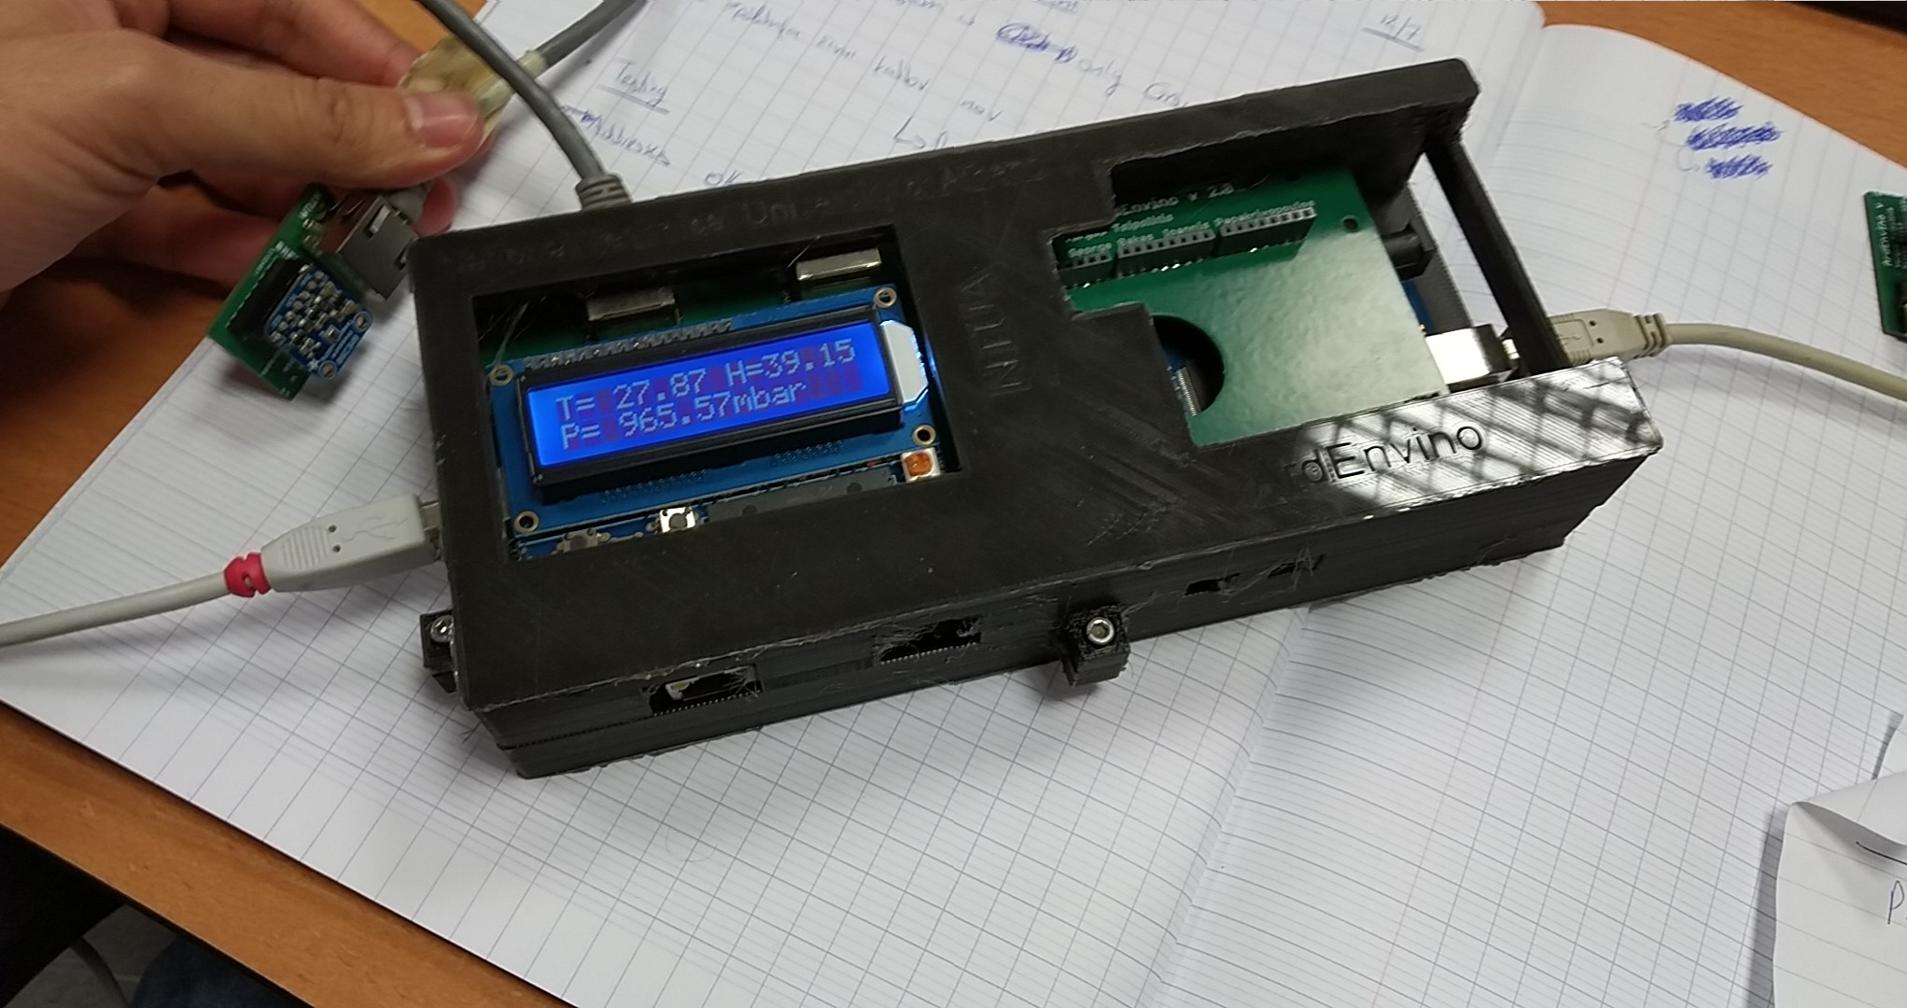
Environmental Monitoring for the RD51 Test Beams
Development of the slow control system
Developed environmental monitoring system
Support during test beams

Slide 27
Conclusions
Contribution to the CMS DCS group
Maintenance and development of new tools
Measurement of Top – antitop quark production cross section for Full Run II data collected with CMS detector
Combination of three years
Systematic variations evaluation
HGCAL
DCS
PLC control and monitoring
RD51
Environmental monitoring parameters
Slow Control System for High Voltage monitoring

Slide 28
BACKUP SLIDES

Slide 29
Signal Selection
Control Region Selection
Variables | Selected Cut
pT (both leading jets) | > 400 GeV
Njets | > 1
N leptons | = 0
|eta| (both leading jets) | < 2.4
mJJ | > 1000 GeV
jetMassSoftDrop (only for fit) | (50,300) GeV
Top Tagger | > 0.2, 0, 0.1
B tagging (2 btagged jets) | > Medium WP
Signal Trigger
Variables | Selected Cut
pT (both leading jets) | > 400 GeV
Njets | > 1
N leptons | = 0
|eta| (both leading jets) | < 2.4
mJJ | > 1000 GeV
jetMassSoftDrop (only for fit) | (50,300) GeV
Top Tagger | > 0.2, 0, 0.1
B tagging (0 btagged jets) | < Medium WP
Control Trigger

Slide 30
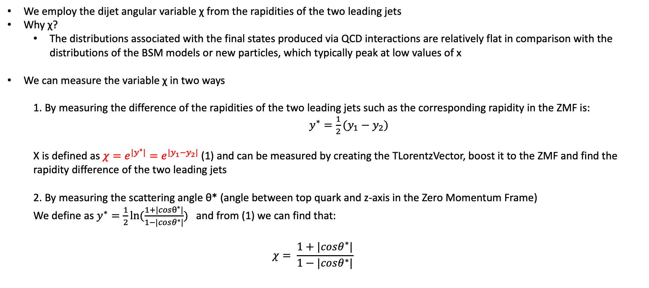
Top Angular Distributions
We employ the dijet angular variable χ from the rapidities of the two leading jets
Why χ?
The distributions associated with the final states produced via QCD interactions are relatively flat in comparison with the distributions of the BSM models or new particles, which typically peak at low values of x
We can measure the variable χ in two ways
1. By measuring the difference of the rapidities of the two leading jets such as the corresponding rapidity in the ZMF is: $y^{∗}=\frac{1}{2}(y_{1}−y_{2})$
Χ is defined as $χ=e^{{|y}^{∗}|}=e^{|y_{1}−y_{2}|}$ (1) and can be measured by creating the TLorentzVector, boost it to the ZMF and find the rapidity difference of the two leading jets
2. By measuring the scattering angle θ* (angle between top quark and z-axis in the Zero Momentum Frame)
We define as $y^{∗}=\frac{1}{2}ln⁡(\frac{1+|cosθ^{∗}|}{1−|cosθ^{∗}|})$ and from (1) we can find that:
$$χ= \frac{1+|cosθ^{∗}|}{1−|cosθ^{∗}|}$$

Slide 31
Overview: Discriminator, Efficiency and Acceptance
2016
The discriminator is a BDT trained individually for 2016, 2017 and 2018
Category training: split the sample in categories based on Pt
Bins:
[400, 600] GeV
[600, 800] GeV
[800, 1200] GeV
[1200, inf) GeV
BDT, used variables:
Leading and Sub-leading subjet mass
N-Subjetiness variables (tau1, tau2, tau3)
fraction of the jetPt over the total pt sum of the event.
Energy correlation functions (ecfB1N2,ecfB1N3, ecfB2N2, ecfB2N3)
BDT Output consistency for the 3 years
Calculation of Efficiency and acceptance for each year
We choose the WP’s for each year so that the leading jet p_{T} efficiency is similar for all years
2017
2018

Slide 32
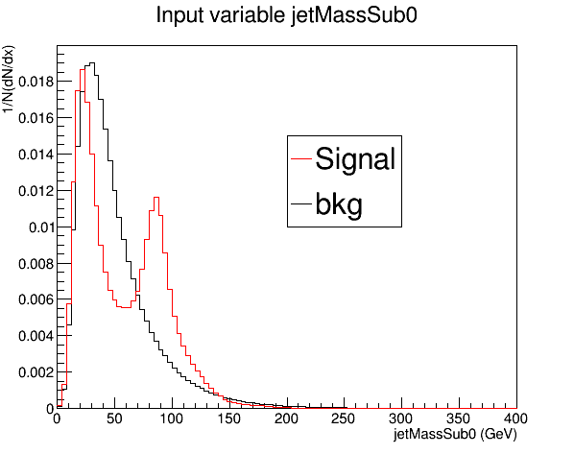
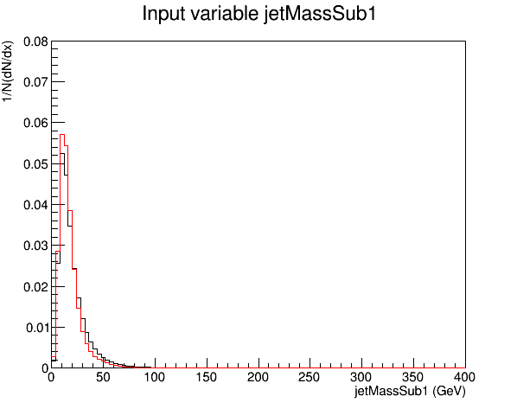




Training variables 2017

Slide 33




Training variables 2017

Slide 34

Signal Extraction
$$S_{1.5TeV}\left(x_{reco}\right)=D_{1.5TeV}\left(x_{reco}\right)−QCD_{1.5TeV}\left(x_{reco}\right)−Sub_{1.5TeV}\left(x_{reco}\right)→$$
Where $QCD_{1.5TeV}\left(x_{reco}\right)=D_{1.5TeV, shape}^{0−btag}\left(x_{reco}\right)xN_{SR(1.5TeV)}{xC}_{closure}^{shape SF}$
and $N_{SR(1.5TeV)}=R_{yield}^{1TeV→1.5TeV}xN_{SR\left(1TeV\right)}^{QCD}=R_{yield}^{1TeV→1.5TeV}xR_{yield}^{SR_{A}→SR} {xN}_{SR_{A}}^{QCD}$
The variable of interest here: x_{reco} → χ
1.5 TeV refers to the mJJ cut
We deploy a fit in the Signal Region (2btag) to extract the $N_{QCD}^{fit}$ in SRA (mJJ > 1TeV)
$$D{\left(m^{t}\right)}^{(i)}=N_{tt}^{(i)}T^{(i)}\left(m^{t},k_{MassScale}, k_{MassResolution}\right)+N_{bkg}^{(i)}B\left(m^{t} \right)\left(1+k_{1}x\right)+N_{sub}^{(i)}O^{(i)}\left(m^{t}\right)$$

